Slide 1

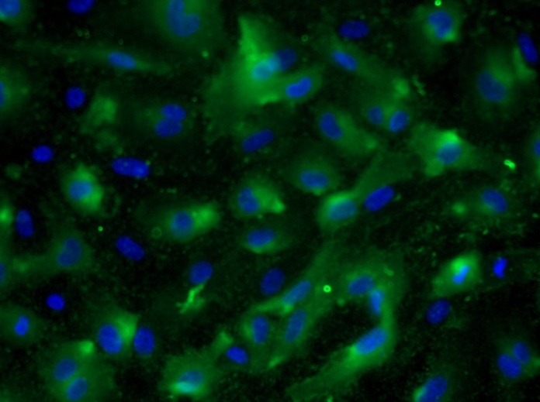
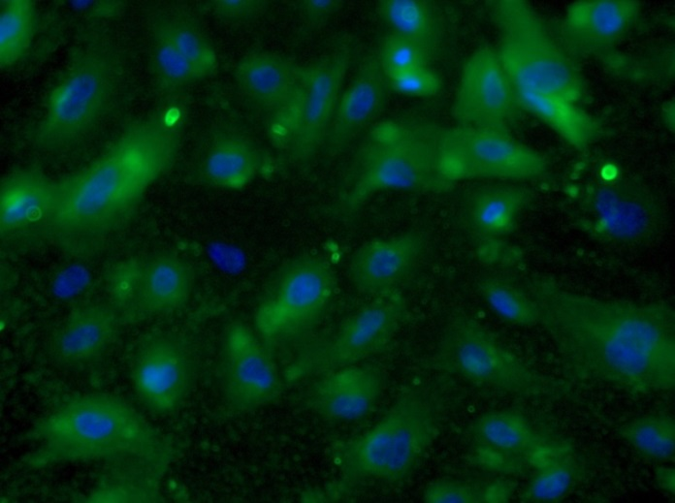
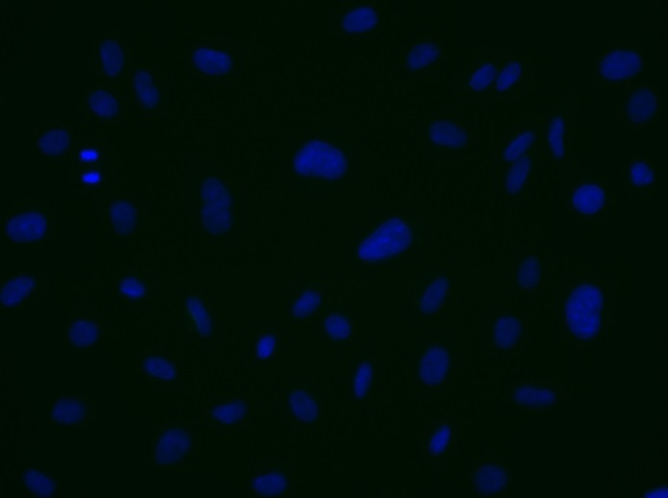
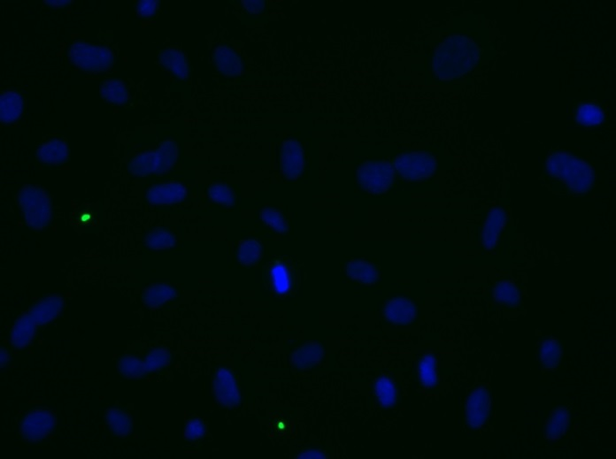
Reliatech GmbH
Anti-human VEGFR-2/KDR
(Cat# 101-M34 [7.5µg/ml]; HUVEC)
Immunofluorescence staining of human VEGFR-2/KDR (#101-M34) primary human umbilical vein endothelial cells (HUVEC) using a monoclonal antibody directed against the extracellular domain of KDR.
As secondary antibody goat anti-mouse ALEXA Flour 488 (Dianova; 1:600) was used. [IF_HU1407-01]
.
mouse anti-human KDR
mouse anti-human KDR
Control (goat anti-mouse IgG ALEXA Flour 488)
Control (goat anti-mouse IgG ALEXA Flour 488)
http://www.reliatech.de / orders@reliatech.de

